Slide 1
London Calling
Springboard
Fall 2020
Summary London by the Numbers
How have housing prices changed 1995-2020
What Effect has Brexit had on the Housing Market
Which are the most Posh London Boroughs
What are the Current Average Home Prices in London Today

Slide 2
London by the Numbers
9.06M
3.59M
£81,608
£533,806
Londoners
Residential Homes
Average Home Price 1995
Average Home Price 2020
London’s population has grown 30% since 1995 The population is expected to grow to 10.35 M by 2041¹
Numbers of dwellings in London range from 6,450 (City of London) to
159, 469 (Croydon) ²
In 1995, London was coming out of the recession before the last one.
Home prices have increased over 500% on Average.
£1,315,151
9.04%
0.79%
91.27%
Average Price in Kensington
Pre-Brexit CAGR
Distribution Centres
Drop in CAGR Post-Brexit
London’s most borough is Kensington & Chelsea, accounting for 8% of London’s residential market value.
The compound annual growth rate of home values in London from 1995 to the 2016 referendum vote.
The compound interest rate following the June 2016 referendum vote on Brexit.
The decision to exit the European Union has had its effect on the residential housing market.

Slide 3
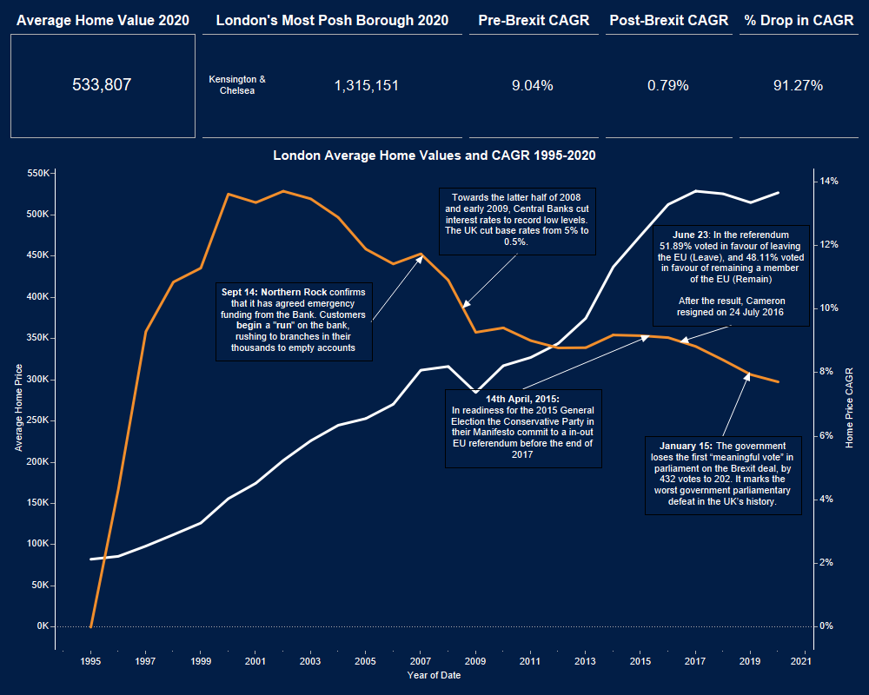

Slide 4
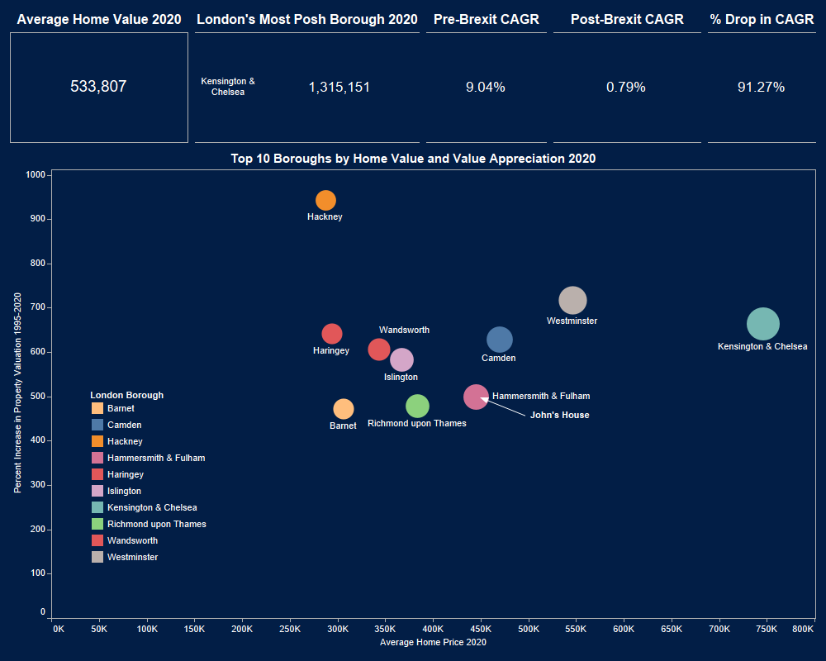

Slide 5
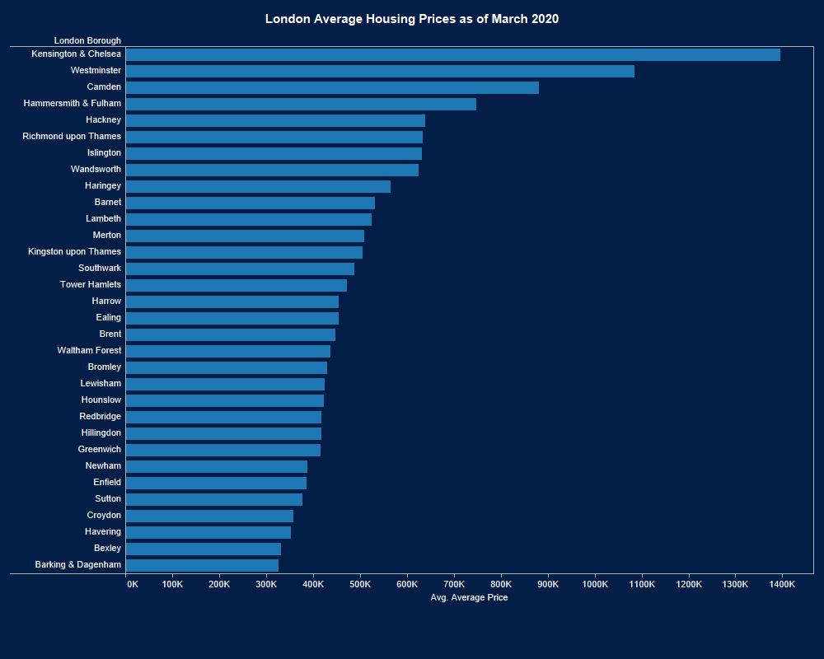

Slide 6
London Calling
References
1 “Number of dwellings in London 2019 | Statista.” [Online]. Available: https://www.statista.com/statistics/585272/number-of-dwellings-london-uk/. [Accessed: 22-Aug-2020].
2 G. London Authority, “Housing in London 2019,” 2019.
Tableau Dashboard
https://us-west-2b.online.tableau.com/t/nov8ai/views/London/Summary?:showAppBanner=false&:display_count=n&:showVizHome=n&:origin=viz_share_link

